Slide 1
MAV Waveform Detection
Try Some New ML based Approaches
Prasun Agarwal, Neema Davis Kachappilly

Slide 2
Results for 1D YoLo V3
Approach:
1D Yolo V3 and Resnet architecture.
Detection based algorithm which uses bounding windows for detection.
The input data is a waveform, the start of ramp and the width of the ramp.
Output data is to predict at which point the ramp starts and the corresponding width associated with it.
Experiments:
Different batch sizes (1, 8 and 16)
Different loss functions (Yolo made custom loss function)
Different optimizers (Adam, Rms Prop)
Different activation functions (Sigmoid, Swish)
Diving images into set of consecutive 10,000 points.
Reducing the complexity of network architecture.
Conclusions:
The model was not able to learn well. It gave a lot of false predictions.
From the results it can be seen that loss is not converging and becomes stagnant at a point.
Reasons anticipated are that the data is highly imbalanced (only 5-6 ramps are there per 12,80,000 points)
These imbalances make it difficult for a model to learn and produce desired outcomes.
Instead, we end up predicting Junk results.

Slide 3
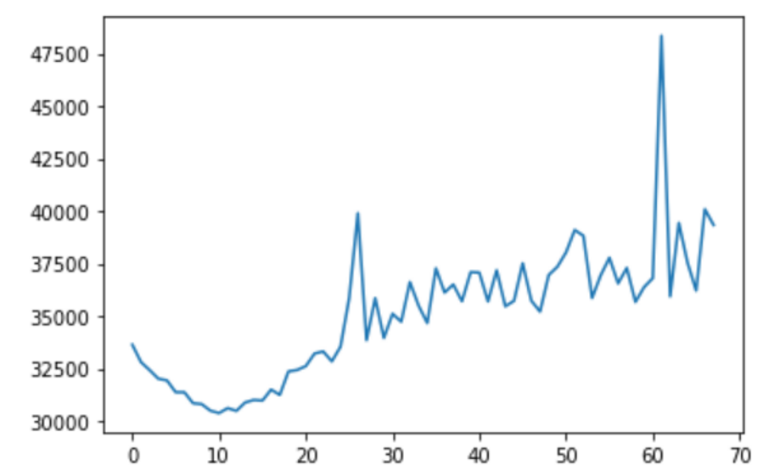
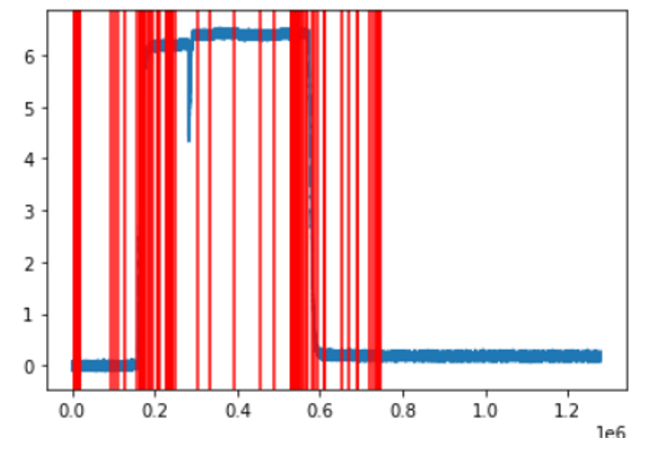
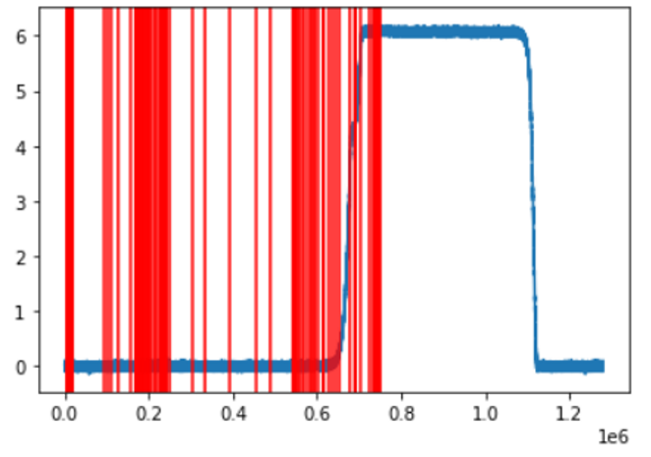
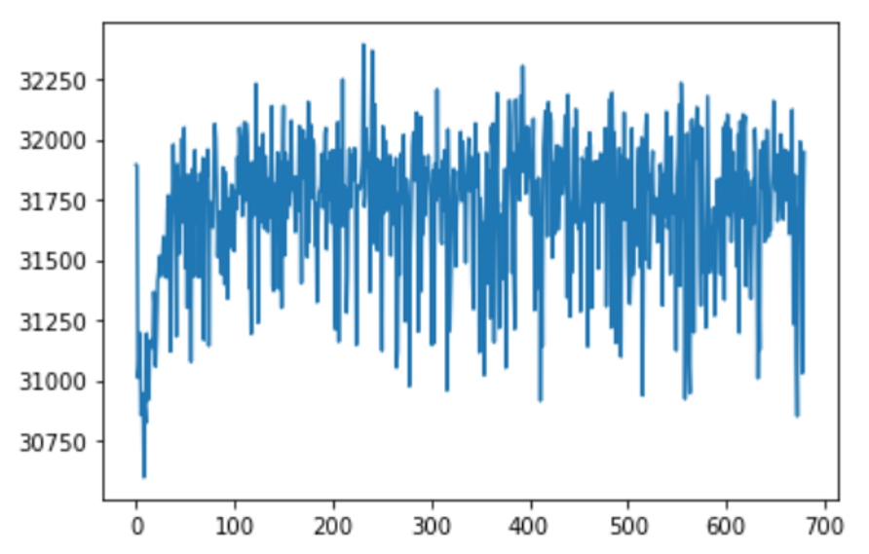
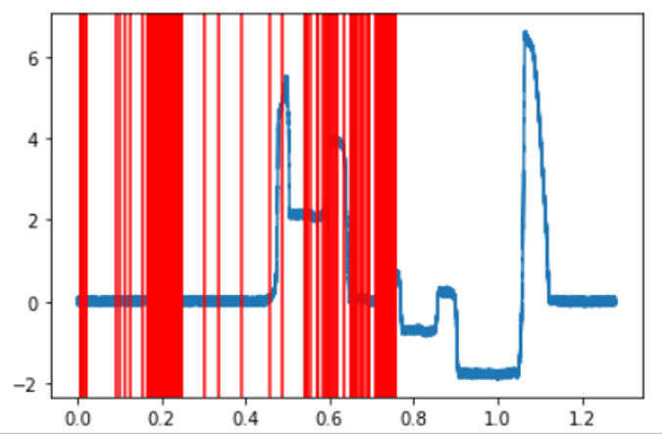
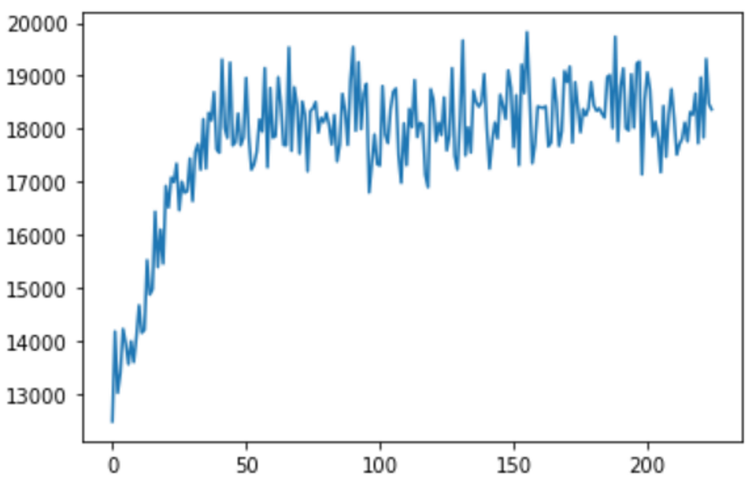
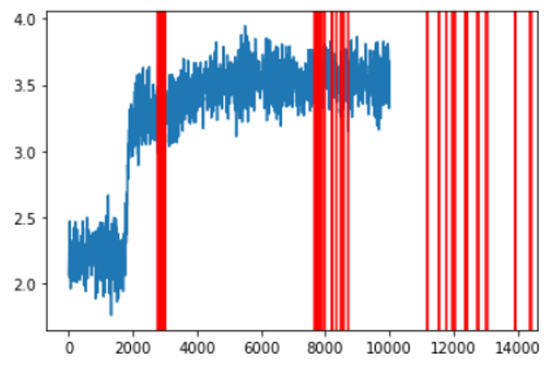
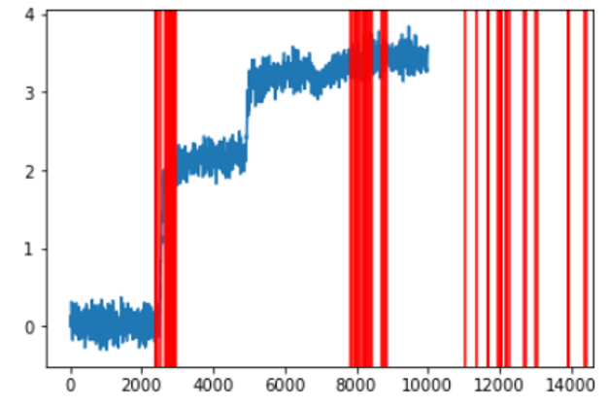
Results for Yolo V3
Batch Size 8
No resizing
No scheduler
Batch Size 1
Down sampling
LR/ Exponential scheduler
Batch Size 4
10,000 points
Down sampling
LR/ Exponential scheduler

Slide 4
New Project Ideas for Waveform Detection
The Yolo architecture is too complex.
Try with a simple CNN based Detection model.
LSTM based model
Convert the problem into a classification problem (classify for each small image if it has a ramp or not).
Try Open CV based techniques (Novelty Detection, Time Series Anomaly)
Pattern/Template matching (Multiscale template matching, normalizing, mean squares etc.)
Looking for local outliers (DB Scan, Isolation Forest, PyOD).

Slide 5
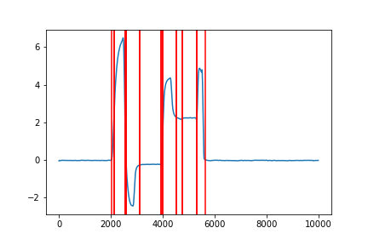
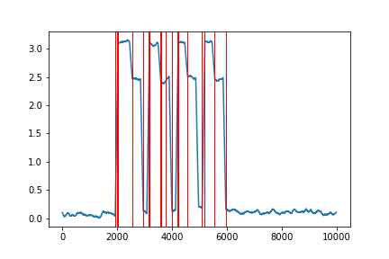
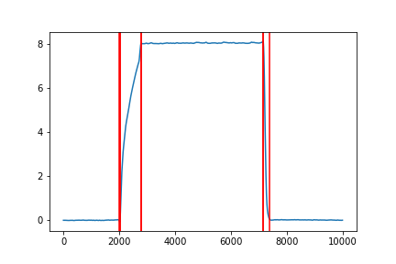
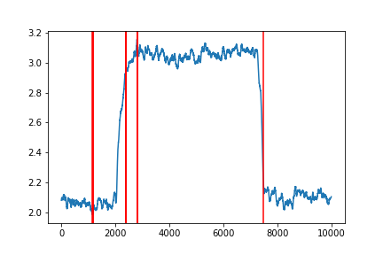
Results for DB Scan
Down sampled by a factor of 1000.
Smoothened using savgol window of 100 size and polynomial order 3
Looks for outliers in Local Area
Local window of size 100
Epsilon = 0.01
Grouped nearby ramps as one
Some false positives are being detected.
Need to counter that, can think of some post filtering as a next step.

Slide 6
Progress PPT from here

Slide 7
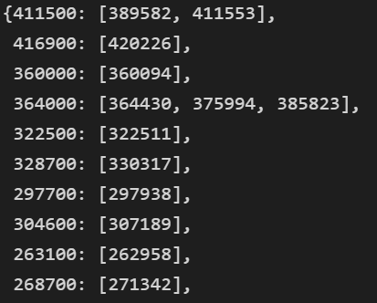
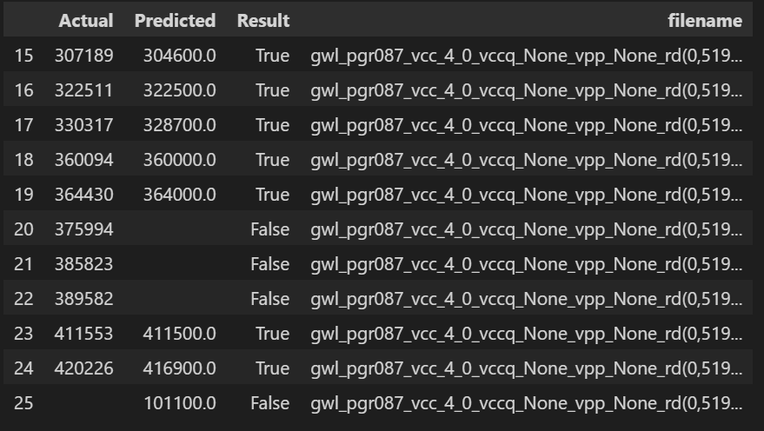
Error Analysis Report
Earlier multiple predicted values were mapped to a single actual value.
Predicted value may fall outside +/- 1% error range and still be captured, without being flagged as a FP or FN.
Even if FP or FN exist, no clear idea about which points are actually FP or FN.
Earlier Analysis
Error Analysis Report
False Negative
False Positive
False Negative = There is an actual ramp, but nothing is predicted there.
False Positive = There is no actual ramp, but a ramp point is predicted.

Slide 8
How is Error Analysis Report prepared?
How
Consider the first actual value.
Use np.argmin to find the closest predicted value.
Check if the predicted value is not flagged (not used/ not mapped) earlier to any actual value.
Check if this predicted value lies in +/- 1% error range (deviation) or not.
Do the process in a non chronological order (rather in a parallel fashion) so mapping is done correctly.
The parallel fashion means consider not only the current actual value, but also the next actual value.
Advantages of Error Analysis Report
Finds the predicted values which is closest to the actual value.
Check for the error range (else considered as a False Positive).
One-on-One mapping is considered. (One actual value is mapped to only one predicted value and vice versa).
All happens in a parallel manner.

Slide 9
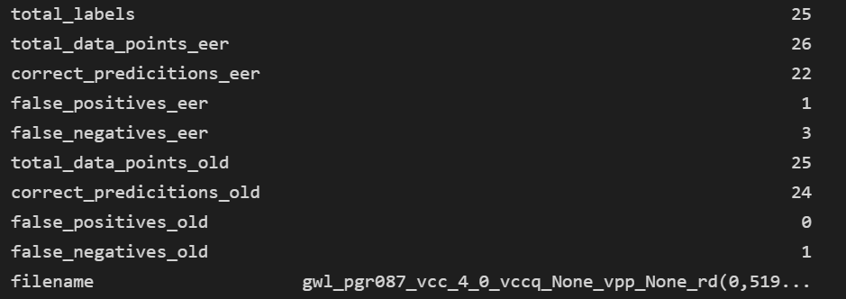
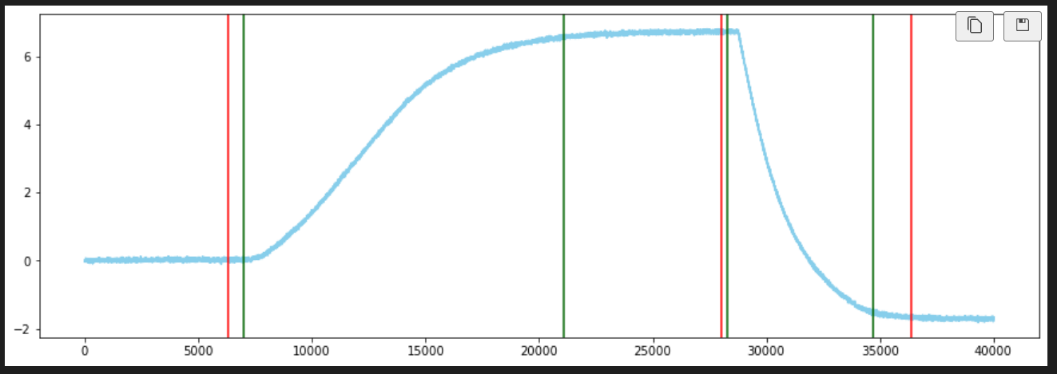
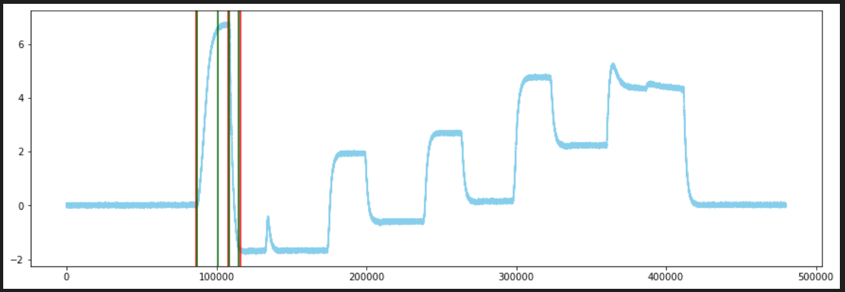
Example1:
Report
Read Waveform N58R (False Positive not captured by earlier version due to incorrect mapping)
Path = gwl_pgr087_vcc_4_0_vccq_None_vpp_None_rd(0,519,336,1)__Group0_labeled.h5
Earlier analysis shows 0 FP.
New analysis (Error Analysis Report) shows 1 FP.
The highlighted ramp is a FP.
FP here means there is no actual ramp, but something is predicted there.
Earlier, this was getting mapped to the previous actual ramp.
Now, being correctly captured as a FP.
Zoomed in
Zoomed Out

Slide 10
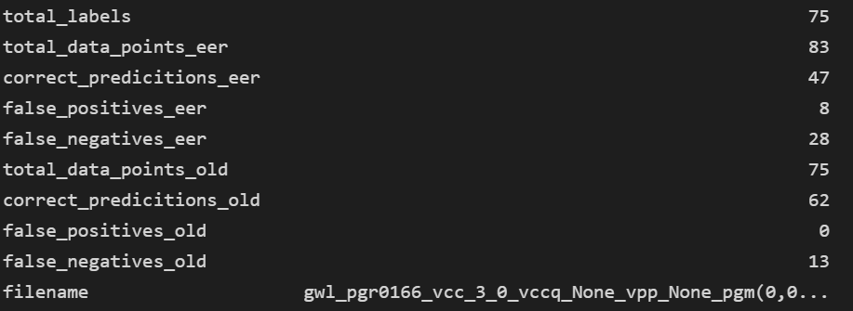
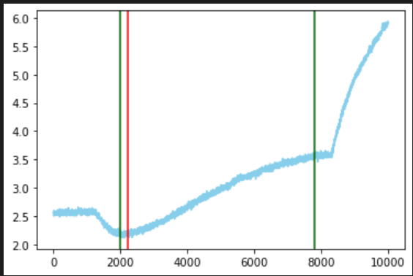
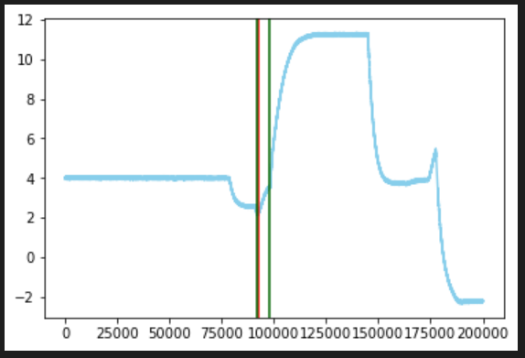
Example2:
Report
Program Waveform N58R (False Positive not captured by earlier version due to incorrect mapping)
Path = gwl_pgr0166_vcc_3_0_vccq_None_vpp_None_pgm(0,0,636,1,0,0,636,4)__Group0_labeled (1).h5
Now in previous version this predicted was getting mapped to first original and we said there is no FP
But actually, here is a FP because ideally there is no ramp and we predicted something here.
Similarly, there are 8 other FP’s but earlier version shows 0.
Zoomed in
Zoomed Out

Slide 11
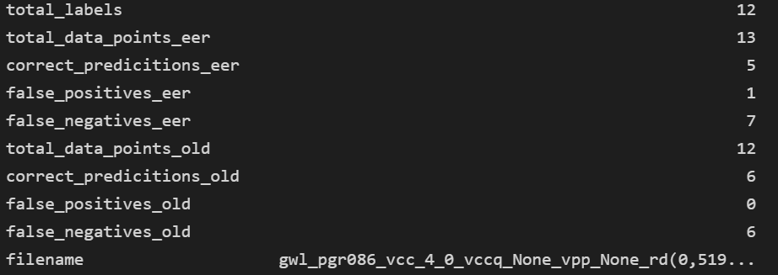
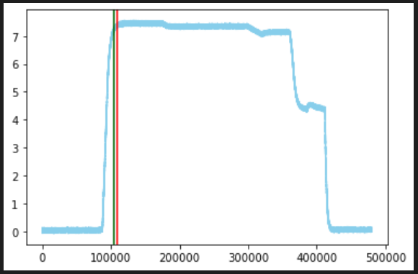
Example3:
Report
Read Waveform N58R (False Positive not captured by earlier version due to deviation)
Path = gwl_pgr086_vcc_4_0_vccq_None_vpp_None_rd(0,519,336,1)__Group0_labeled.h5
In the previous version, the deviation was not taken into account while mapping.
This ignores our +/- 1% error range criteria.
It is mapped to the nearest value, and shows 0 FP.
In the current report, +/- 1% deviation is taken into account while mapping.
Since actual point 109698 deviation window is (108601, 110794) and predicted label 104000 does not lie in this window, predicted is considered as a FP, and actual as FN (as no ramp is there).

Slide 12
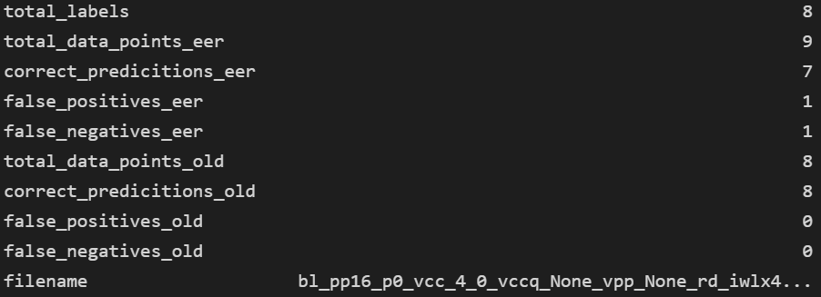
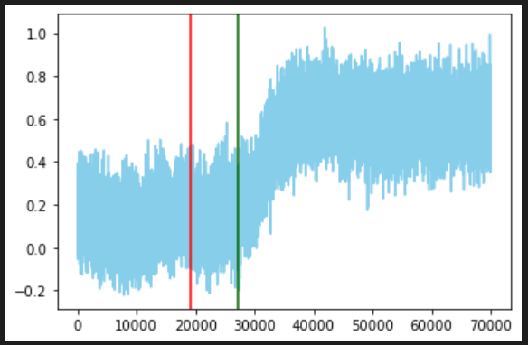
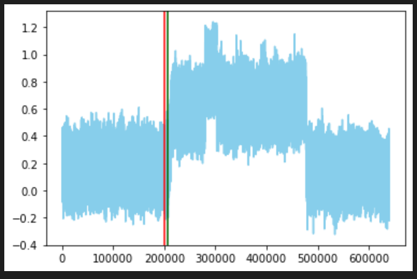
Example4:
Report
IWL Waveform N58R (False Positive not captured by earlier version due to due to deviation)
Path = bl_pp16_p0_vcc_4_0_vccq_None_vpp_None_rd_iwlx4_vdof_ardy_fine(0,1,3,10,336,,1,1,10,336,,1,2,10,336,,1,0,10,336,0,9495,1)__Group0_lp_labeled.h5
In the previous version, the deviation was not taken into account while mapping.
This ignores our +/- 1% error range criteria.
It is mapped to the nearest value, and shows 0 FP.
In the current report, +/- 1% deviation is taken into account while mapping.
Since actual point 199222 deviation window is (199222*0.99, 199222*1.01) and predicted label 207100 does not lie in this window, it is considered as a FP. 199222 has no corresponding predicted ramp, hence is a FN.
Zoomed in
Zoomed Out

Slide 13

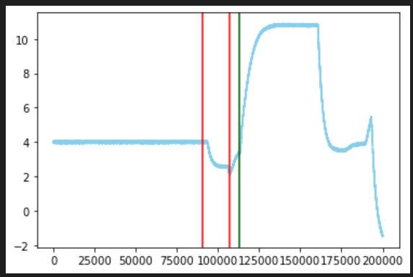
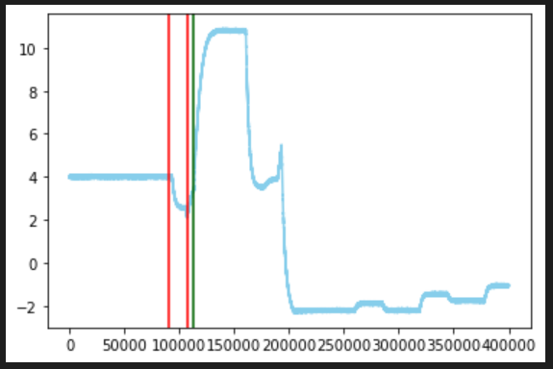
Example5:
Report
Program Waveform N58R (False Negative not captured by earlier version due to incorrect mapping)
Path = gwl_pgr0166_vcc_3_0_vccq_None_vpp_None_pgm(0,0,636,1,0,0,636,4)__Group0_labeled (1).h5
Here 313200 is the predicted data points and corresponding two actual points (290445, 307025) are mapped to it.
So essentially, we say there should be two predictions for two actuals, but here only one.
This reduces our no of false negative in earlier version.
Actual count of FN which is 28 was earlier given as only 18.
Zoomed in
Zoomed Out

Slide 14

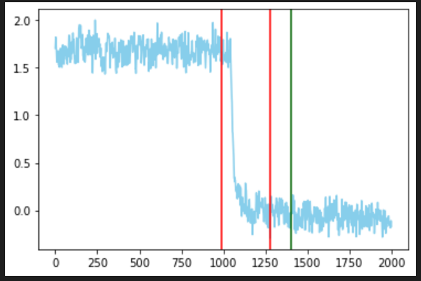
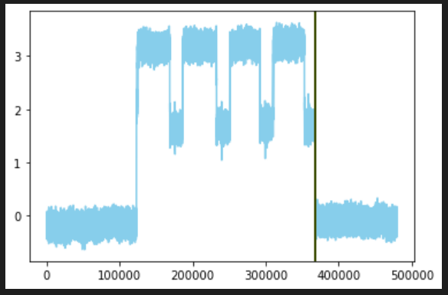
Example7:
Report
Read Waveform N58R (False Negative not captured by earlier version due to incorrect mapping)
Path = blclamp2_4k0_p0_vcc_4_0_vccq_None_vpp_None_rd(0,519,639,1)__Group0_qlc_labeled.h5’
Here in this case both of these actual red are mapped to single green predicted, this reduces the no of FN
But EER does one-to-one mapping, so it is shown as FN
Actual count of FN which is actually 1 was given as only 0 earlier.
No problem with DAC values here.
Zoomed in
Zoomed Out

Slide 15
Mislabeling of Data

Slide 16
Example1:
Report
Read Waveform (Ramp end point not marked correctly)
Path = gwl_pgr087_vcc_4_0_vccq_None_vpp_None_rd(0,519,336,1)__Group0_labeled.h5
The highlighted ramp point is not marked.
It is being predicted correctly.
But since there is no actual ramp given there, it adds up to the number of FP.
Zoomed in
Zoomed Out

Slide 17
Example2:
Report
Program Waveform N58R (Ramp end point not marked correctly, mid way ramps present)
Path = gwl_pgr0166_vcc_3_0_vccq_None_vpp_None_pgm(0,0,636,1,0,0,636,4)__Group0_labeled (1).h5
Here some ramp has been predicted , but when seen from the actual data, there is no corresponding ramp there.
When zoomed in, it shows that slope actually changes there and it is a mid way ramp.
This is not labelled and is leading to increase in number of FP’s.
Zoomed in
Zoomed Out

Slide 18

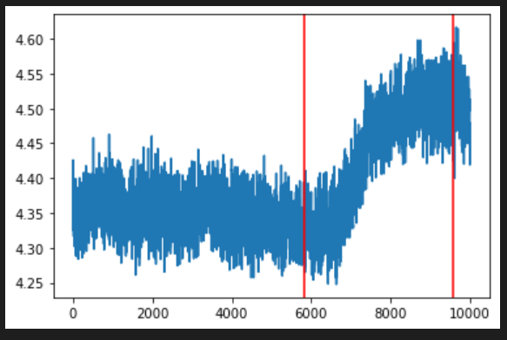
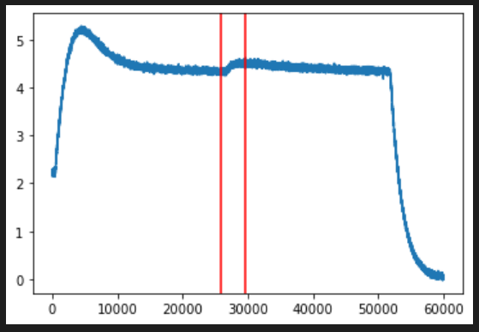
Example3:
Report
Read Waveform N58R (DAC value suggest does not match here)
Path = gwl_pgr087_vcc_4_0_vccq_None_vpp_None_rd(0,519,336,1)__Group0_labeled.h5
Here the two ramp point labels are 385823, 389582.
Corresponding y_diff (deviation in y direction) is 0.13201523 which is less than the minimum DAC value of 0.2, so it is noise which has been marked as a ramp.
One of the other criteria to eliminate the FP are if the deviation is y direction is less than 10% or not. Here the deviation is only 1.52%, hence it was ignored.
Now this is popping up as a FN and is leading to increase in number of FN’s.
Zoomed in
Zoomed Out

Slide 19

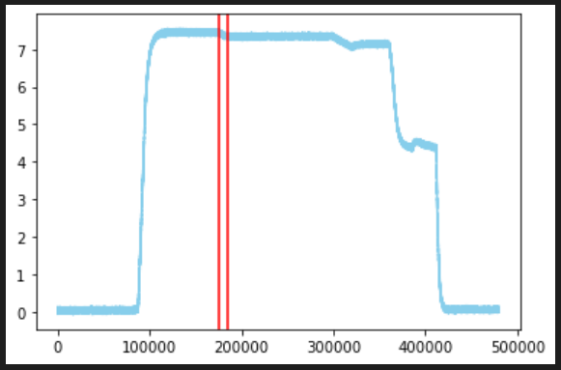
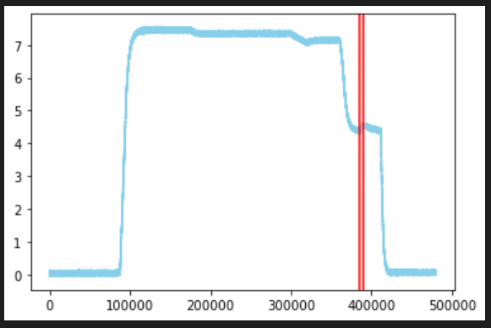
Example4:
Report
Read Waveform N58R (DAC value suggest does not match here)
Path = gwl_pgr086_vcc_4_0_vccq_None_vpp_None_rd(0,519,336,1)__Group0_labeled.h5
Here for this ramp DAC is less than 0.1, but still it is given as ramp
For example 1, the points labelled are as (175570, 184816), whose values are:
DAC = 0.09757614 < 0.2
% deviation in y direction = 1.2 % < 10%
For example 2, the points labelled are as (297492, 319738), whose values are:
DAC = 0.13966846 < 0.2
% deviation in y direction = 1.82 % < 10%
The criterions to eliminate the FP is if the deviation is y direction is less than 10% or not. Now this is popping up as a FN and is leading to increase in number of FN’s.
Example 1
Example 2

Slide 20
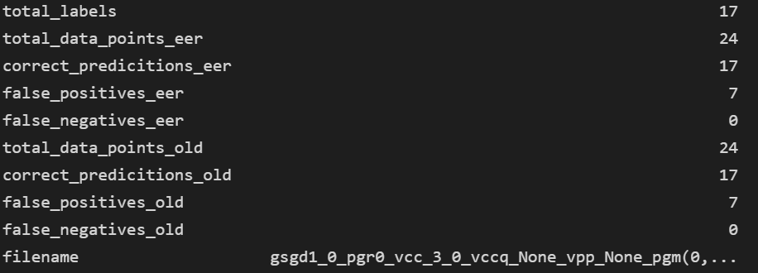
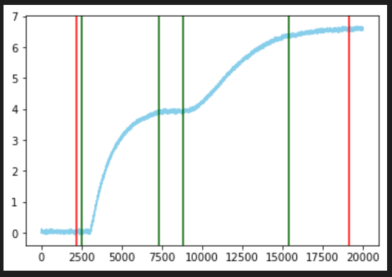
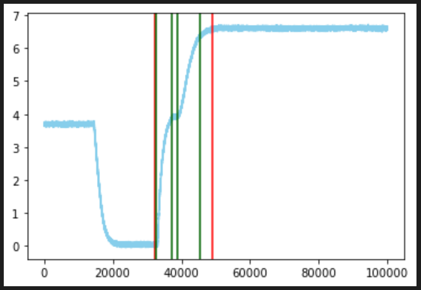
Example5:
Report
Program Waveform N58R (Missing Ramps)
Path= boost_4k0_vcc_3_0_vccq_None_vpp_None_pgm_no_pps(0,0,636,1,0,0,636,4)__Group0_labeled (1).h5’
These middle two green ones are also ramps but is not marked.
They both mark a beginning and end of two different ramps.
Instead of taking it as a one big ramp, it should be two separate ramps.
This pops up as a FP and is leading to increase in number of FP’s.
Zoomed in
Zoomed Out

Slide 21
New Version of Code

Slide 22
Comparison Table
Challenges to Previous Version | Advantages of New Approach
Results given in terms of start and end time indices. Rather, SME’s want results in terms of transition points. | Uses the criteria of density in a local neighborhood. Results are now given as a list of transition points as desired by SME’s. Also gives an added advantage to apply various post-filtering techniques to eliminate the false positives.
A lot of tunable parameters are there. Instead, SME’s wants minimal human intervention from their side. | Eliminates the need for tuning a lot of parameters, instead let the model decide the local and global thresholds.
Need of Secondary Ramp detection when the ramps are not predicted as per desired. The need can be decided only once the results are given, not before hand. Also is costly and time-consuming affair. | No need for secondary ramp detection. Two list of points predicted will be given to the end user, depending on weather small ramps are needed or not, any of those can be used.
Down sampling may neglect small variations which are sometimes very necessary for a few cases. | No down sampling needed. A million data points can be handled easily in seconds of time.
Y direction threshold (0.2 DAC value) is fixed. But can vary depending on the noise level of the waveform. | Y-direction threshold is not fixed. Instead, it is depended on the noise level of the waveform.

Slide 23
Results
The following tests are run on B48R waveform.
This is the test data where no actual ground truth labels are provided.
There are 3 categories of waveforms Read, Erase and Program.
The following waveforms are being shown in the slides:
Read:
Read Waveform 1 : EXP2_SQ1_wl_37837_X24497_Y-62422_na_na_30C.h5
Read Waveform 2 : EXP1_SQ3_src_gate_e_p0_X39084_Y-74380_na_na_30C.h5
Erase:
Erase Waveform 1 : EXP10_SQ11_vpass_pgr_0_X47195_Y-46587_na_na_30C.h5
Erase Waveform 2 : EXP10_SQ7_src_gate_o_p0_X39050_Y-76974_na_na_30C.h5
Program:
Program Waveform 1 : EXP1_SQ4_swvpx_pgr0_X32664_Y-47254_na_na_30C.h5
Program Waveform 2 : EXP1_SQ1_sgd4_l_155_X24497_Y-68518_na_na_30C.h5"

Slide 24
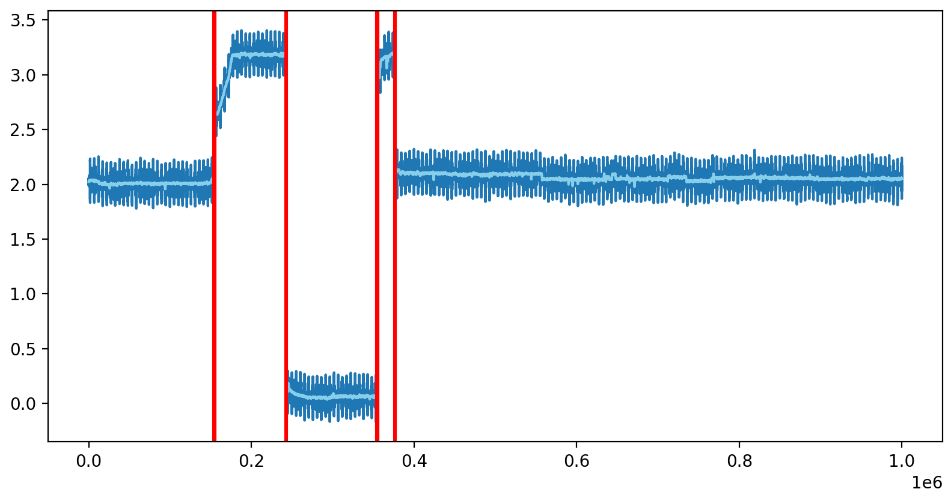
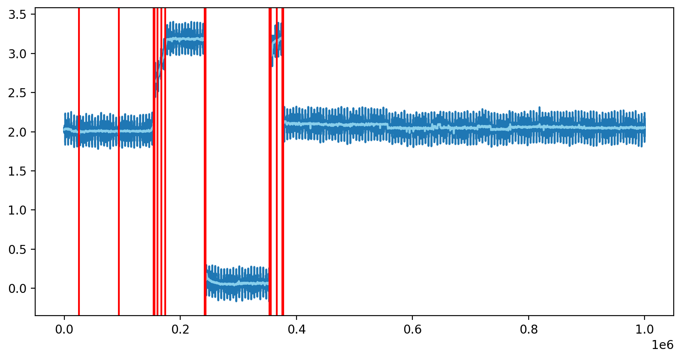
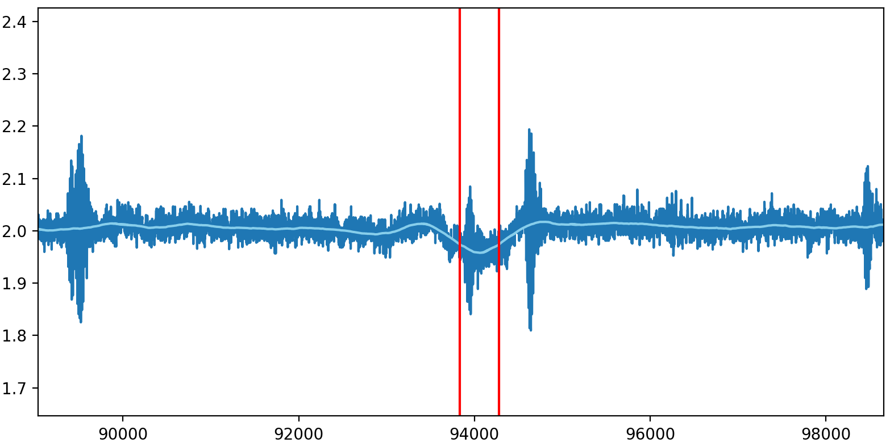
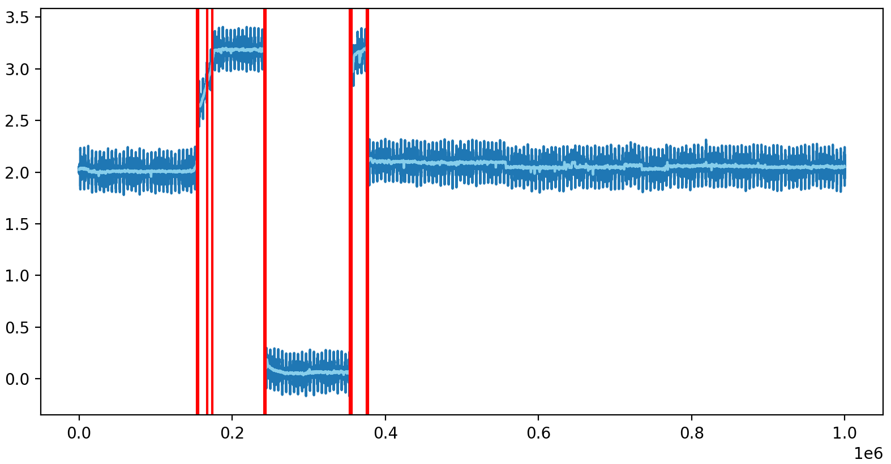
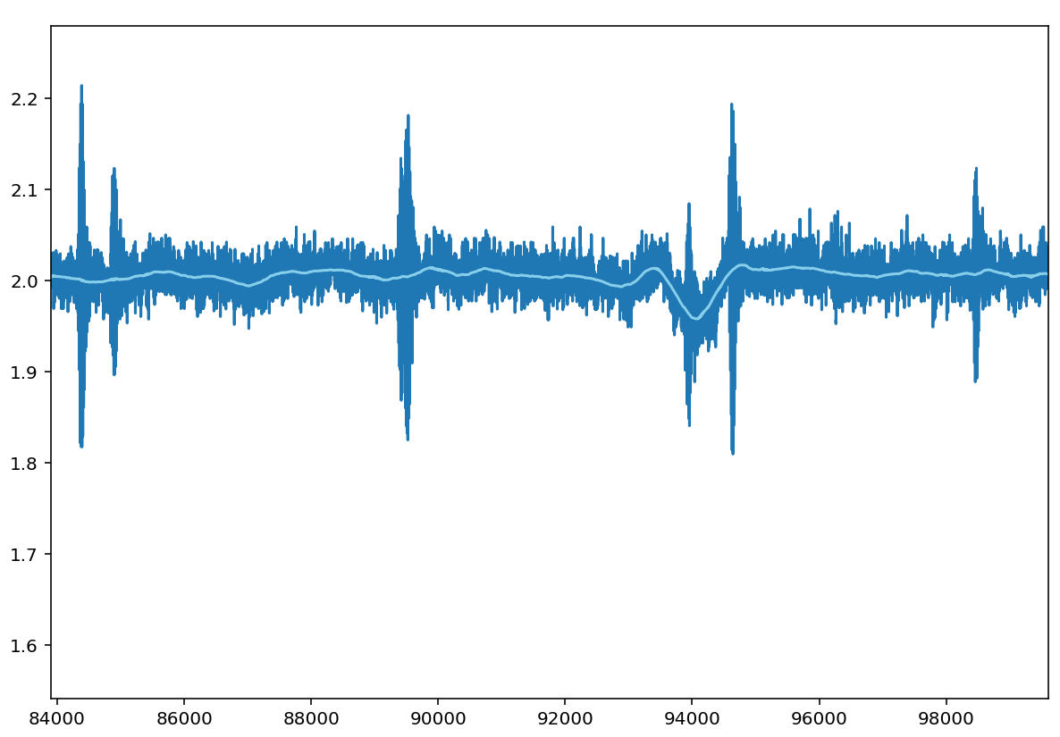
Read Waveform 1
Previous Version
Predicted No of Points = 6
Time taken = 2.4 sec
Tunable parameters = x_th, y_th, min_height_of_ramp, min_distance_between_ramps, secondary_detection_needed
Remarks = Makes good predictions but lot of time taken
New Version (Predictions 1)
Predicted No of Points = 10
Time taken = 0.27 sec
Tunable parameters = None
Remarks = Small ramps are also detected
New Version (Predictions 2)
Predicted No of Points = 8
Time taken = 0.3 sec
Tunable parameters = None
Remarks = Small ramps are correctly ignored

Slide 25
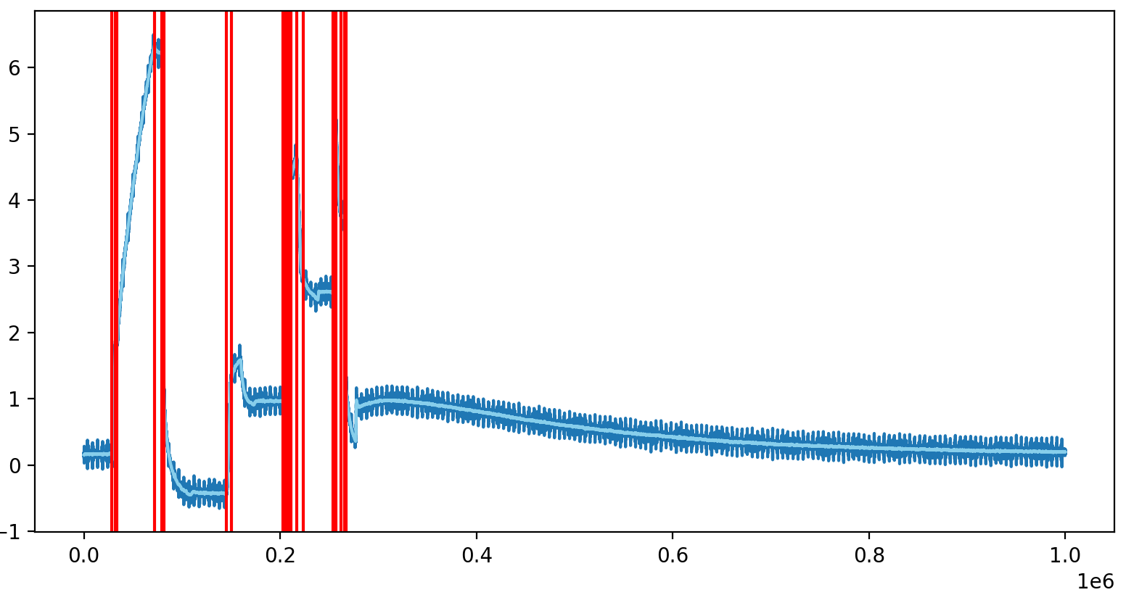
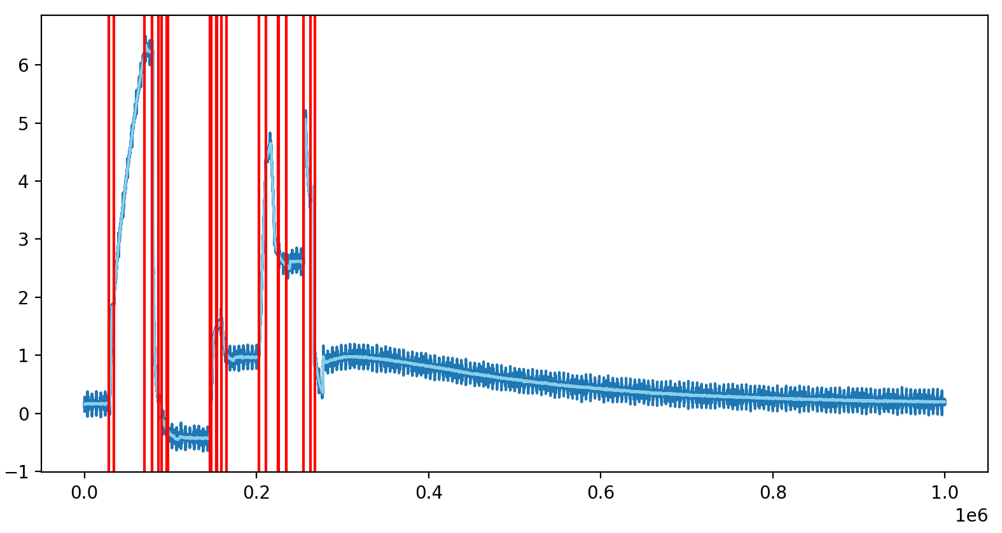
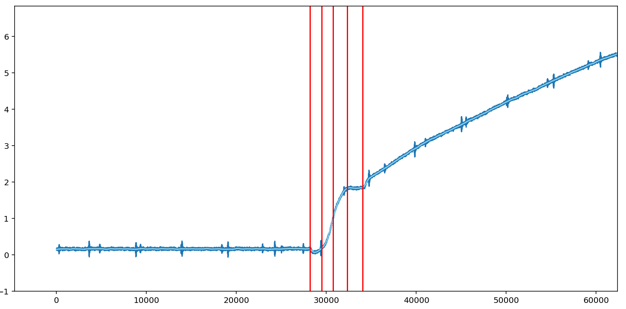
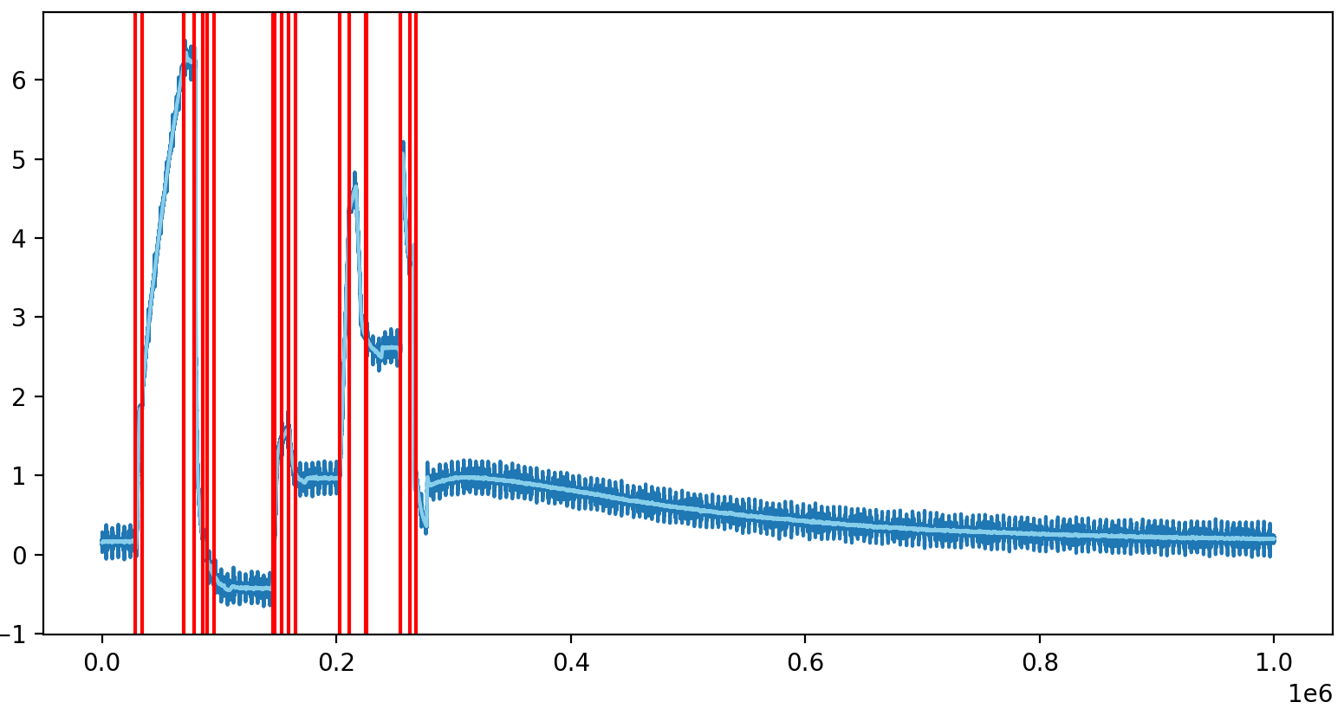
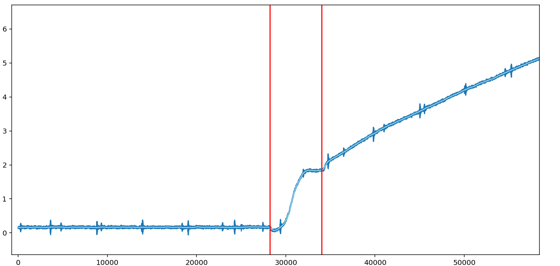
Read Waveform 2
Previous Version
Predicted No of Points = 22
Time taken = 2.9 sec
Tunable parameters = x_th, y_th, min_height_of_ramp, min_distance_between_ramps, secondary_detection_needed
Remarks = Makes good predictions but lot of time taken
New Version (Predictions 1)
Predicted No of Points = 65
Time taken = 0.4 sec
Tunable parameters = None
Remarks = Even smaller ramps are correctly marked
New Version (Predictions 2)
Predicted No of Points = 20
Time taken = 0.88 sec
Tunable parameters = None
Remarks = Clubs all smaller ramps as one single ramp

Slide 26
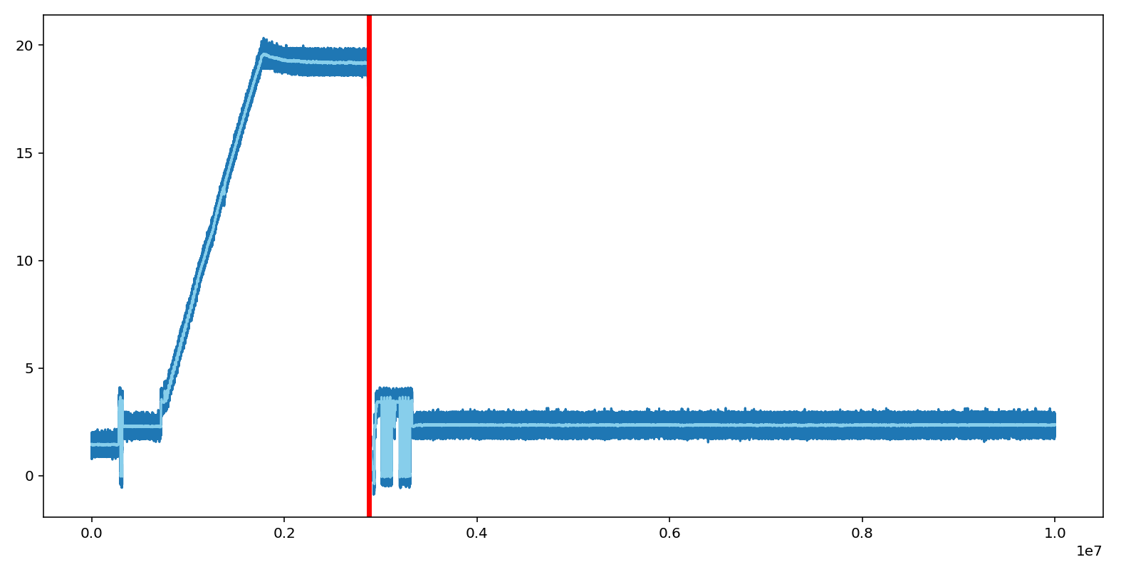
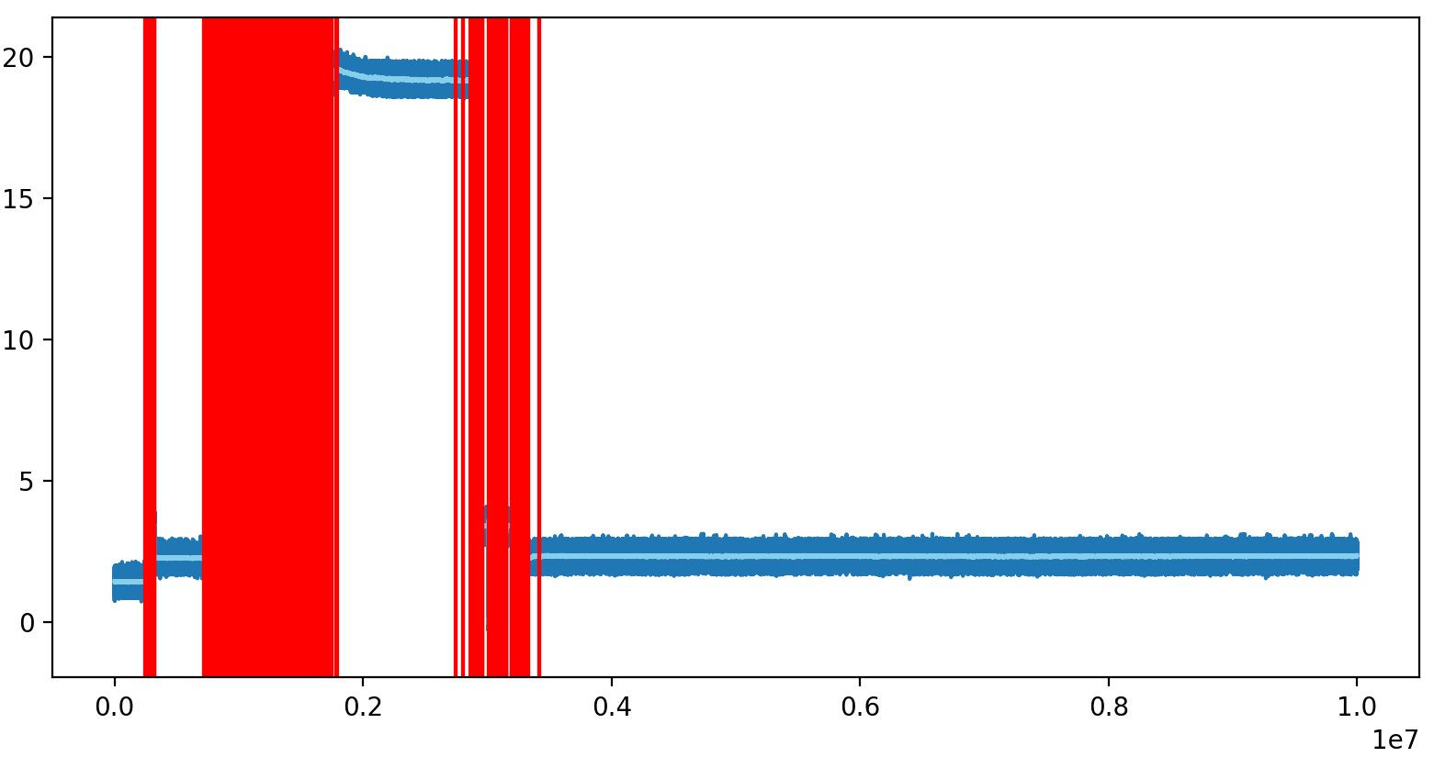
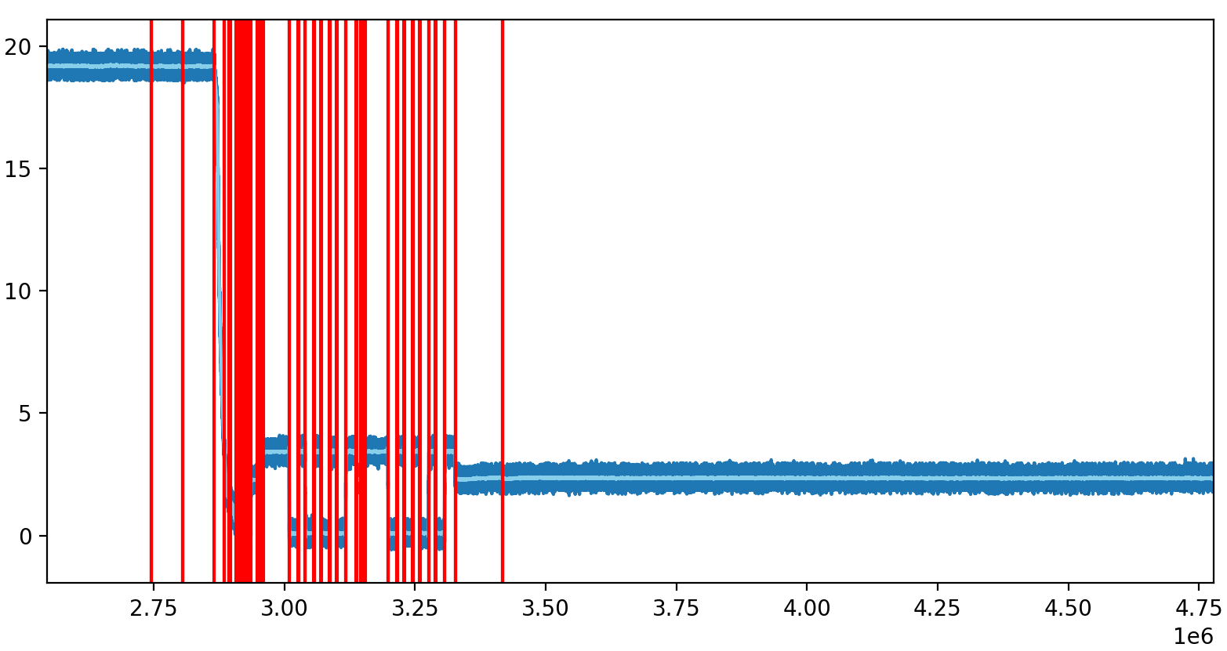
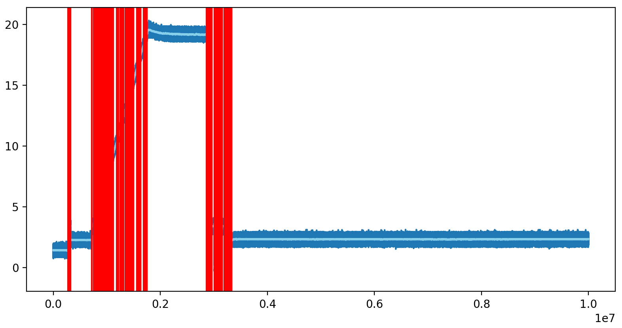

Erase Waveform 1
Previous Version
Predicted No of Points = 3
Time taken = 18.57 sec
Tunable parameters = x_th, y_th, min_height_of_ramp, min_distance_between_ramps, secondary_detection_needed
Remarks = Makes very bad predictions, very few points predicted. Lot of time is also taken. Additional time needed for secondary detection
New Version (Predictions 1)
Predicted No of Points = 815
Time taken = 3.57 sec
Tunable parameters = None
Remarks = Makes good predictions in small time frame.
New Version (Predictions 2)
Predicted No of Points = 154
Time taken = 4.1 sec
Tunable parameters = None
Remarks = Makes good predictions in small time frame

Slide 27





Erase Waveform 2
Previous Version
Predicted No of Points = 6
Time taken = 14.8 sec
Tunable parameters = x_th, y_th, min_height_of_ramp, min_distance_between_ramps, secondary_detection_needed
Remarks = Makes very bad predictions, very few points predicted. Lot of time is also taken. Additional time needed for secondary detection
New Version (Predictions 1)
Predicted No of Points = 120
Time taken = 3.4 sec
Tunable parameters = None
Remarks = Make good predictions in small time interval
New Version (Predictions 2)
Predicted No of Points = 33
Time taken = 3.9 sec
Tunable parameters = None
Remarks = Make good predictions in small time interval

Slide 28





Program Waveform 1
Previous Version
Predicted No of Points = 176
Time taken = 3.7 sec
Tunable parameters = x_th, y_th, min_height_of_ramp, min_distance_between_ramps, secondary_detection_needed
Remarks = Makes good predictions. Additional time need for points predicted. Lot of time needed for secondary detection
New Version (Predictions 1)
Predicted No of Points = 186
Time taken = 0.82 sec
Tunable parameters = None
Remarks = Good Prediction, Detects smaller ramps, Less time taken
New Version (Predictions 2)
Predicted No of Points = 107
Time taken = 0.88 sec
Tunable parameters = None
Remarks = Good Prediction, Does not detects smaller ramps, Less time taken

Slide 29





Program Waveform 2
Previous Version
Predicted No of Points = 178
Time taken = 2.61 sec
Tunable parameters = x_th, y_th, min_height_of_ramp, min_distance_between_ramps, secondary_detection_needed
Remarks = Makes good predictions. Additional time need for points predicted. Lot of time needed for secondary detection
New Version (Predictions 1)
Predicted No of Points = 108
Time taken = 0.42 sec
Tunable parameters = None
Remarks = Good Prediction, Detects smaller ramps, Less time taken
New Version (Predictions 2)
Predicted No of Points = 60
Time taken = 0.88 sec
Tunable parameters = None
Remarks = Good Prediction, Does not detects smaller ramps, Less time taken

Slide 30
Local Maxima and Minima

Slide 31
Previous Approach
Used DB Scan Algorithm to find outliers.
Used a 100 nanoseconds window size.
Used a 20-degree slope criteria.
Used scipy peak_find to find peaks and troughs.
A lot of tunable parameters were needed.
Not able to detect smaller peaks.
New Approach
Input is only a waveform.
Find peaks in local maxima and minima.
No other input needed.
Only number of local inputs to be considered at a time is needed (default = 100)
Reduced No of missed ramps earlier from 66% to now only 2%.
All ramps correctly predicted with >90% accuracy.
Reduction in number of False Detection earlier from 82% to now only 9%

Slide 32


Previous approach
New Approach
Total Number of predictions = 8
Correct Prediction = 6
Wrong Prediction = 2
Missed = 44
Total Number of predictions = 50
Correct Prediction = 50
Wrong Prediction = 0
Missed = 0
Waveform Name = EXP1_SQ3_RB_na_na_30C.h5

Slide 33


Previous approach
New Approach
Total Number of predictions = 22
Correct Prediction = 21
Wrong Prediction = 1
Missed = 287
Total Number of predictions = 310
Correct Prediction = 308
Wrong Prediction = 2
Missed = 0
Waveform Name = EXP1_SQ4_vpassreg_src_pgr_0_X47433_Y88785_na_na_30.h5

Slide 34


Previous approach
New Approach
Total Number of predictions = 22
Correct Prediction = 10
Wrong Prediction = 12
Missed = 23
Total Number of predictions = 36
Correct Prediction = 32
Wrong Prediction = 4
Missed = 1
Waveform Name = EXP1_SQ1_wl_37837_X24497_Y-62422_na_na_30C.h5

Slide 35


Previous approach
New Approach
Total Number of predictions = 223
Correct Prediction = 150
Wrong Prediction = 73
Missed = 851
Total Number of predictions = 1000
Correct Prediction = 995
Wrong Prediction = 5
Missed = 6
Waveform Name = pgm_EXP1_SQ1_wl_37840_X24497_Y-61387_na_na_30C.h5

Slide 36


Previous approach
New Approach
Total Number of predictions = 128
Correct Prediction = 75
Wrong Prediction = 53
Missed = 3
Total Number of predictions = 78
Correct Prediction = 78
Wrong Prediction = 0
Missed = 0
Waveform Name = EXP6_SQ6_sgd1_0_l_620_X24497_Y-68315_na_na_30C.h5

Slide 37


Previous approach
New Approach
Total Number of predictions = 25
Correct Prediction = 20
Wrong Prediction = 5
Missed = 300
Total Number of predictions = 326
Correct Prediction = 320
Wrong Prediction = 0
Missed = 26
Waveform Name = EXP2_SQ4_vpassreg_src_pgr_0_X47433_Y88785_na_na_30C.h5

Slide 38
Improvement of the Smoothening/ Denoising criteria

Slide 39
Present Denoising Criteria
As the waveform is very noisy, it is filtered using a Low pass moving average filter.
The filter goes by name Savgol filter.
The problem arises as the higher frequencies (sharp rise and fall) are filtered out.
This leads to phase shifting when smoothening.
Improved Denoising Criteria
The improved denoising filter uses a Low pass filter.
To make it more dynamic, the window size which was kept constant earlier, is now being made more dynamic.
In case of high frequencies (sharp rise or fall), it is recommended to use a smaller window size to avoid phase shifting.
This helps in proper alignment of the smoothened waveform with that of a noisy waveform.

Slide 40


Example 1:
erase\EXP10_SQ6_sgd2_l_620_X24497_Y-68620_na_na_30C.h5
Window Size : 999 (default)
Remarks : As can be seen the smoothening tilts it.
Window Size : 150
Remarks : As can be seen the smoothening perfectly aligns.

Slide 41


Example 2:
testing_waveforms\new_testing\EXP1_SQ3_RB_na_na_30C.h5
Window Size : 999 (default)
Remarks : As can be seen the smoothening tilts it.
Window Size : 150
Remarks : As can be seen the smoothening perfectly aligns.

Slide 42


Example 3:
programe\EXP1_SQ1_sgd4_l_155_X24497_Y-68518_na_na_30C.h5
Window Size : 999 (default)
Remarks : As can be seen the smoothening tilts it.
Window Size : 150
Remarks : As can be seen the smoothening perfectly aligns.

Slide 43


Example 4:
programe\EXP1_SQ1_sgd4_l_155_X24497_Y-68518_na_na_30C.h5
Window Size : 999 (default)
Remarks : As can be seen the smoothening tilts it.
Window Size : 150
Remarks : As can be seen the smoothening perfectly aligns.

Slide 44



Code Review
Initial score using Pylint. Used Black to improve the formatting.
Added doc strings, removed white spaces, defined all functions extensively
Converted all text to snake_case_naming convention, proper intends, simultaneously reduced code complexity to some extent.

